Slide 1
Lecture 7: Block Cipher Modes of Operation
An Introduction to Information Security
School of Big Data and Software Engineering, CQU
Fall, 2018

Slide 2
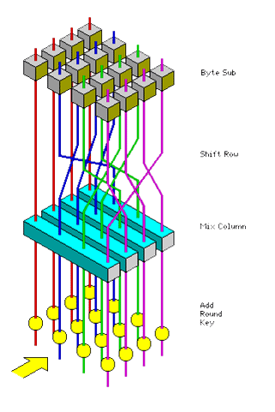
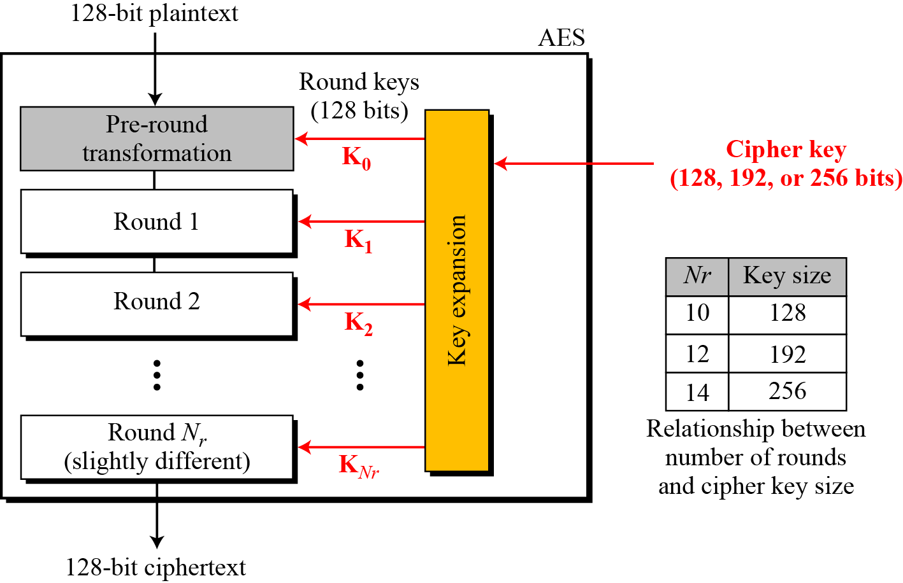
Quickly Review
Lecture 6
Advanced Encryption Standard (AES)
Evaluation Criteria for AES
The AES Cipher
Strength of AES

Slide 3
Quiz
Advanced Encryption Standard:
encrypt 128 -bit block using 128 -bit key with 10 rounds.
the first operations of AES are Byte substitution .
four steps in first 9 rounds are: Byte substitution（字节替换） , shift Rows(循环移动) , Mix Colum , and Add RoundKey .
there is (are) 16 S-box(es) in AES encryption, while there are ? S-boxes in DES.

Slide 4


Slide 5

Outline
1. More Advance Symmetric-key Ciphers
2. Block Cipher Modes of Operation

Slide 6

Lecture 7: Block Cipher Modes of Operation
1. More Advance Symmetric-key Ciphers
2…
1.1 IDEA: International Data Encryption Algorithm,
1992, Lai Xuejia (来学嘉)
64-bits block,
128-bits key
8 rounds
Pa
Pb
Pc
Pd
kia
·
+
kib
kic
+
·
kid
+
+
Round i
kie
·
+
+
xor
+
·
kif
+
模加2¹⁶
+
+
·
模乘2¹⁶+1
+
+

Slide 7

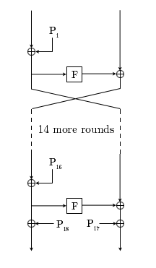
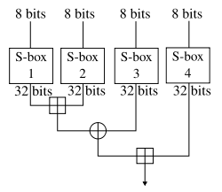
Lecture 7: Block Cipher Modes of Operation
1. More Advance Symmetric-key Ciphers
2…
1.2 Blowfish
Bruce Schneier, 1993
Feistel cipher structure
64-bits Block
32–448 bits Key, 16 rounds
Successor: Twofish
Key Generator
complex

Slide 8
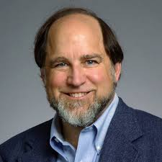
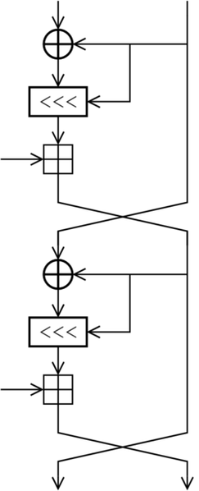
Lecture 7: Block Cipher Modes of Operation
1. More Advance Symmetric-key Ciphers
2…
1.3 RC5
variable block size (32, 64 or 128 bits),
variable key size (0 to 2040 bits) and
variable number of rounds (0 to 255).
The original suggested choice of parameters were a block size of 64 bits, a 128-bit key and 12 rounds.
Successor: RC6

Slide 9
Lecture 7: Block Cipher Modes of Operation
1. More Advance Symmetric-key Ciphers
2…
1.4 characteristics of advanced Block ciphers
Variability （可变性）:
key length
block size
number of rounds
S-boxes
round function
complex round-key generation
more roles of key to perform
S-box
Circular-shift

Slide 10
Outline
1. More Advance Symmetric-key Ciphers
2. Block Cipher Modes of Operation

Slide 11
Lecture 7: Block Cipher Modes of Operation
1…
2. Block Cipher Modes of Operation
2.1 Electronic Codebook (ECB)
2.2 Cipher Block Chaining (CBC)
2.3 Cipher Feedback (CFB)
2.4 Output Feedback (OFB)
2.5 Counter (CTR)

Slide 12
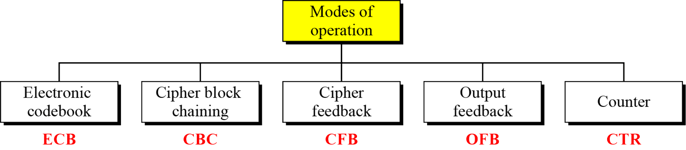
Lecture 7: Block Cipher Modes of Operation
1…
2. Block Cipher Modes of Operation
Symmetric-key encipherment can be done using modern block ciphers.
Modes of operation have been devised to encipher text of any size employing either DES or AES.
In essence(实质上), a mode of operation is technique for enhancing(增强) the effect of a cryptographic algorithm or adapting the algorithm for an application, such as applying a block cipher to a sequence of data blocks of stream.

Slide 13
Lecture 7: Block Cipher Modes of Operation
1…
2. Block Cipher Modes of Operation
2.1 ECB
2.2 CBC
2.3 CFB
2.4 OFB
2.5 CTR
The Electronic CodeBook (电子密码本模式): simplest mode
Each block of plaintext is encoded independently(独立地) using the same key
Time = 1
Time = 2
Time = N
P
The first
m-bit of P
The second
m-bit of P
The nth
m-bit of P
K
encrypt
K
encrypt
K
encrypt
Any Problem?
C
The first
m-bit of C
The second
m-bit of C
The nth
m-bit of C

Slide 14









Lecture 7: Block Cipher Modes of Operation
14
1…
2. Block Cipher Modes of Operation
2.1 ECB
2.2 CBC
2.3 CFB
2.4 OFB
2.5 CTR
The Electronic CodeBook
attack scenario:
accountant
bank
张宗益
id1
date
salary1
salary1
胡海波
id2
date
salary2
What is this attack？
HR
employee
2018/10/27
An Introduction to Information Security

Slide 15
Lecture 7: Block Cipher Modes of Operation
15
1…
2. Block Cipher Modes of Operation
2.1 ECB
2.2 CBC
2.3 CFB
2.4 OFB
2.5 CTR
The Electronic CodeBook
Comments to ECB
the same block of plaintext, if it appears more than once in the message, always produces the same cipher-text.
Can not prevent modification attack for long message
No Error Propagation(传播): A single bit error in transmission can create errors in several (many) bits in the corresponding block. However, the error does not have any effect on the other blocks. (why?)
Usage？
ECB mode is ideal for transmitting a short amount of data, such as an encryption/decryption key, or password.
2018/10/27
An Introduction to Information Security

Slide 16
Lecture 7: Block Cipher Modes of Operation
16
1…
2. Block Cipher Modes of Operation
2.1 ECB
2.2 CBC
2.3 CFB
2.4 OFB
2.5 CTR
To transmit a lengthy message, we might employ the so called Cipher Block Chaining mode (CBC, 密码链模式)；
P₁
P₂
P_{N}
n bits
n bits
n bits
IV
C_{N-1}
+
+
+
K
E
K
E
K
E
Q1: Decryption?
n bits
n bits
n bits
C₁
C₂
C_{N}
2018/10/27
An Introduction to Information Security

Slide 17
Lecture 7: Block Cipher Modes of Operation
17
1…
2. Block Cipher Modes of Operation
2.1 ECB
2.2 CBC
2.3 CFB
2.4 OFB
2.5 CTR
To transmit a lengthy message, we might employ the so called Cipher Block Chaining mode (CBC, 密码链模式)；
P₁
P₂
P_{N}
n bits
n bits
n bits
IV
C_{N-1}
+
+
+
K
D
K
D
K
D
Q1: Decryption?
n bits
n bits
n bits
Q2: what’s IV?
C₁
C₂
C_{N}
2018/10/27
An Introduction to Information Security

Slide 18
Lecture 7: Block Cipher Modes of Operation
18
1…
2. Block Cipher Modes of Operation
2.1 ECB
2.2 CBC
2.3 CFB
2.4 OFB
2.5 CTR
CBC Decryption
It can be proved that encryption and decryption are inverses(互逆) of each other:
Pi=D_{K}(C_{i})⊕C_{i-1} =D_{K}(E_{K}(P_{i}⊕C_{i-1}))⊕C_{i-1} =P_{i}⊕C_{i-1}⊕C_{i-1}
What is IV?
Initialization Vector(初始向量): To produce the first block of ciphertext, an initialization vector IV is XORed with the first block of plaintext.
The IV must be know to both the sender and receiver.
Typical Application:
General purpose block oriented transmission
Message Authentication(消息鉴别)
2018/10/27
An Introduction to Information Security

Slide 19
Lecture 7: Block Cipher Modes of Operation
19
1…
2. Block Cipher Modes of Operation
2.1 ECB
2.2 CBC
2.3 CFB
2.4 OFB
2.5 CTR
What happen if we wish to transmit a lengthy message in real time?
2018/10/27
An Introduction to Information Security

Slide 20
Lecture 7: Block Cipher Modes of Operation
20
1…
2. Block Cipher Modes of Operation
2.1 ECB
2.2 CBC
2.3 CFB
2.4 OFB
2.5 CTR
The Cipher Feedback mode (CBF, 密码反馈模式)
IV
S₁
n bits
S₂
N-r bits
C1
S_{N}
N-r bits
C_{N-1}
K
E
K
E
K
E
T₁
k1
T₂
k₂
T_{M}
k_{N}
Q1: Decryption?
r bits
r bits
r bits
r bits
r bits
r bits
r bits
r bits
r bits
r bits
+
r bits
+
r bits
+
P₁
C₁
P₂
C₂
P_{N}
C_{N}
2018/10/27
An Introduction to Information Security

Slide 21
Lecture 7: Block Cipher Modes of Operation
21
1…
2. Block Cipher Modes of Operation
2.1 ECB
2.2 CBC
2.3 CFB
2.4 OFB
2.5 CTR
The Cipher Feedback mode
IV
S₁
n bits
S₂
N-r bits
C1
S_{N}
N-r bits
C_{N-1}
K
E
K
E
K
E
T₁
k1
T₂
k₂
T_{M}
k_{N}
Q1: Decryption?
r bits
r bits
r bits
r bits
r bits
r bits
r bits
r bits
r bits
r bits
+
r bits
+
r bits
+
P₁
C₁
P₂
C₂
P_{N}
C_{N}
2018/10/27
An Introduction to Information Security

Slide 22
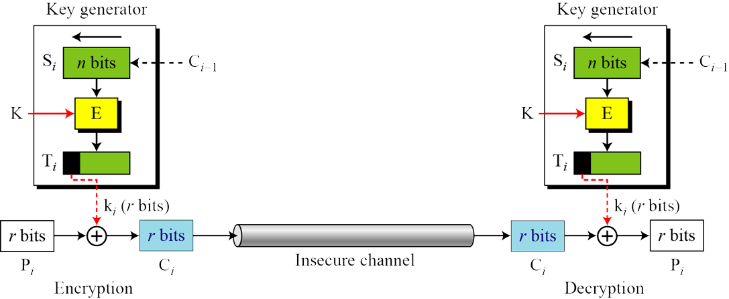
Lecture 7: Block Cipher Modes of Operation
22
1…
2. Block Cipher Modes of Operation
2.1 ECB
2.2 CBC
2.3 CFB
2.4 OFB
2.5 CTR
The Cipher Feedback mode:
Typical Applications:
General Purpose stream oriented transmission
Any Problem?
2018/10/27
An Introduction to Information Security

Slide 23
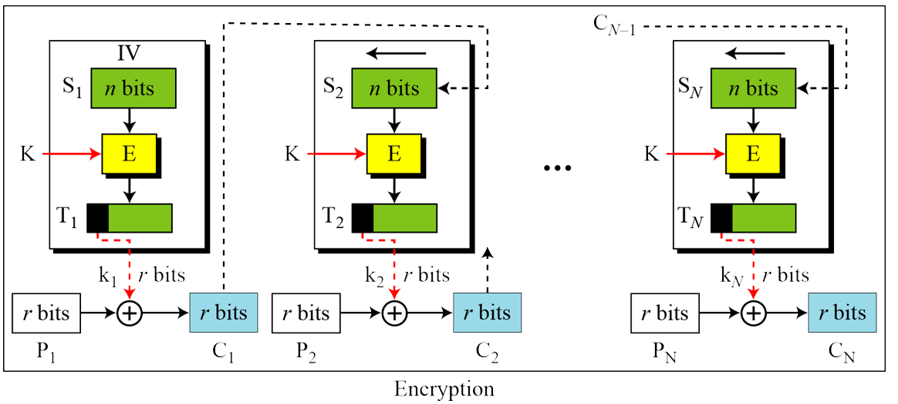
Lecture 7: Block Cipher Modes of Operation
23
1…
2. Block Cipher Modes of Operation
2.1 ECB
2.2 CBC
2.3 CFB
2.4 OFB
2.5 CTR
The Cipher Feedback mode: Error Propagation
Message Authentication
In reliable channel
2018/10/27
An Introduction to Information Security

Slide 24
Lecture 7: Block Cipher Modes of Operation
24
1…
2. Block Cipher Modes of Operation
2.1 ECB
2.2 CBC
2.3 CFB
2.4 OFB
2.5 CTR
The Output Feedback Mode ( 输出反馈模式)
similar to CFB., but…
IV
S₁
n bits
S₂
N-r bits
k₁
S_{N}
N-r bits
k_{N-1}
K
E
K
E
K
E
T₁
k1
T₂
k₂
T_{M}
k_{N}
Error Propagation?
r bits
r bits
r bits
r bits
r bits
r bits
r bits
r bits
r bits
r bits
+
r bits
+
r bits
+
P₁
C₁
P₂
C₂
P_{N}
C_{N}
2018/10/27
An Introduction to Information Security

Slide 25
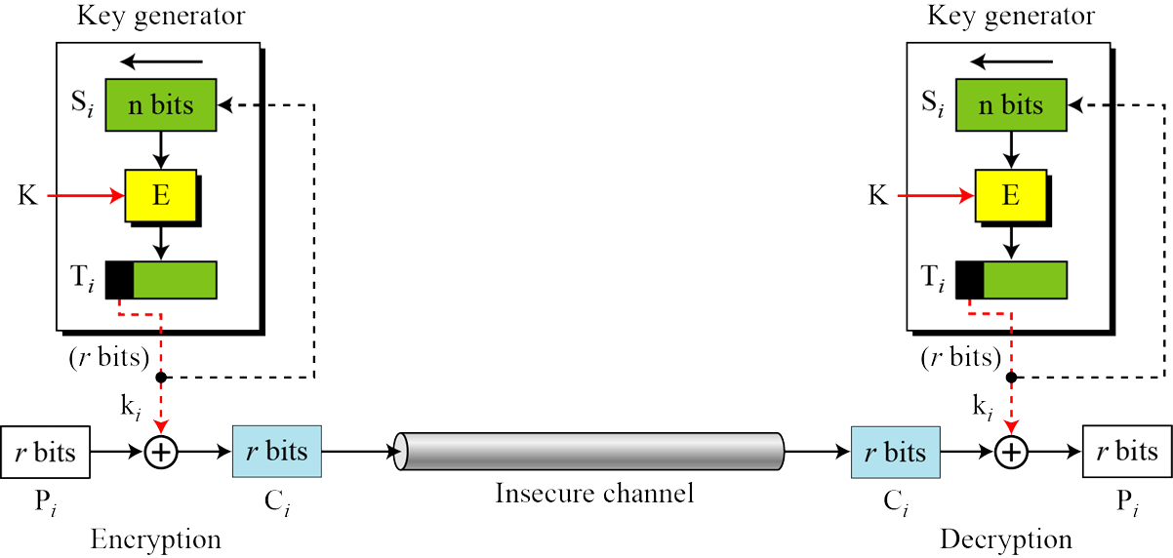
Lecture 7: Block Cipher Modes of Operation
25
1…
2. Block Cipher Modes of Operation
2.1 ECB
2.2 CBC
2.3 CFB
2.4 OFB
2.5 CTR
The Output Feedback Mode：
OFB as a stream cipher
can be used in un-reliable channel
2018/10/27
An Introduction to Information Security

Slide 26
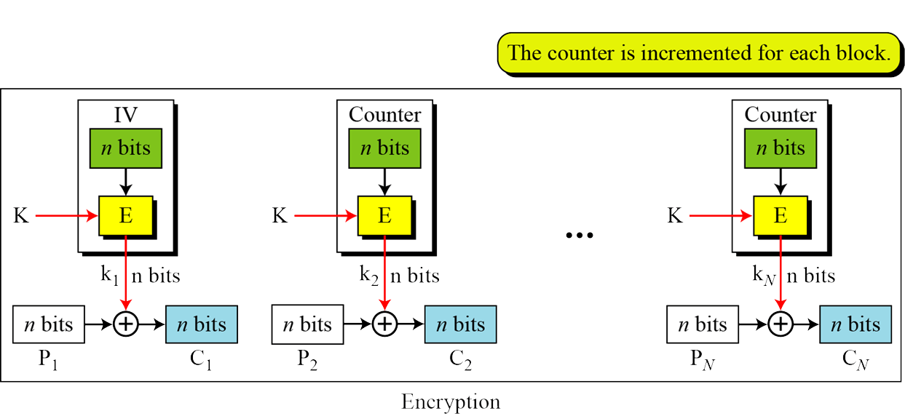
Lecture 7: Block Cipher Modes of Operation
26
1…
2. Block Cipher Modes of Operation
2.1 ECB
2.2 CBC
2.3 CFB
2.4 OFB
2.5 CTR
In the counter (CTR) mode, there is no feedback. The pseudo-randomness(伪随机) in the key stream is achieved using a counter.
2018/10/27
An Introduction to Information Security

Slide 27
Lecture 7: Block Cipher Modes of Operation
Summary
More Advance Symmetric-key Ciphers
IDEA
Blowfish
RC5
Block Cipher Modes of Operation

Slide 28
An Introduction to Information Security
Thanks for your attention!
Q&A

